Slide 1
Parallel & Distributed Computing
Lecture 0
Dr. Faisal Bin Ubaid

Slide 2
Instructor
Faisal Bin Ubaid
faisalbinubaid@iba-suk.edu.pk
Present: Assistant Professor IBA Sukkur
2015-2020: PhD Chongqing University China
2013-2015: Lecturer Military College of Signals (NUST)
MS Bahria University Islamabad 2011 -2012
BS COMSATS University Islamabad 2006-2010

Slide 3
Course Outline

Slide 4
Parallel versus distributed computing
While both distributed computing and parallel systems are widely available these days, the main difference between these two is that a parallel computing system consists of multiple processors that communicate with each other using a shared memory, whereas a distributed computing system contains multiple processors connected by a communication network.

Slide 5
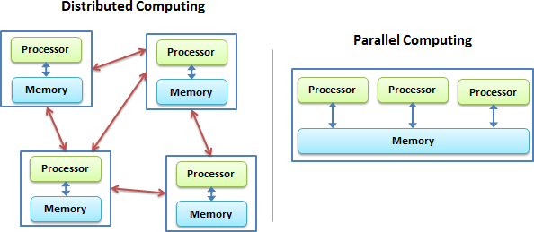

Slide 6
Brief History of Cloud Computing
Millennials may feel like cloud computing is something from their generation, but the truth is that it actually traces its roots back over 60 years.

Slide 7
Brief History of Cloud Computing
Since the 1950s, organizations have been using an increasingly complex and ever-changing system of mainframe computers to process their data.
In the early days, mainframe computers were huge and prohibitively expensive.

Slide 8
This led most organizations to purchase one or two machines and then implement “time-sharing” schedules so that their return on investment (ROI) was as great as possible.
With time-sharing, several users could access a mainframe computer from connected stations that carried no processing power of their own. This type of shared computational power is the basic premise of the cloud.

Slide 9
The Time-Sharing Theory
1955 saw John McCarthy, who originally coined the term “artificial intelligence,” create a theory of sharing computing time among an entire group of users.
Getting the most out of computing time was an important consideration in the 1950s because it was a ridiculously expensive asset, and maximizing it was a top priority

Slide 10
Small companies couldn’t even afford to use computers
McCarthy’s theory of “time-sharing” would be essential in helping get the most out of the computing time available, as well as making computing time available to smaller companies that couldn’t afford to buy their own mainframes

Slide 11
A Giant Step for Cloud Computing
In the mid-1960s, an American computer scientist named J.C.R. Licklider came up with an idea for an interconnected system of computers.
In 1969, Licklider’s revolutionary idea helped Bob Taylor and Larry Roberts develop something known as ARPANET (Advanced Research Projects Agency Network).

Slide 12
ARPANET is widely known as the “predecessor of the Internet” and was the first network that allowed digital sources to be shared among computers that were not in the same physical location.
On the basis of above advancement , there was emergence of cloud computing concepts that later implemented.

Slide 13
At around in 1961, John MacCharty suggested in a speech at MIT that computing can be sold like a utility, just like a water or electricity.
It was a brilliant idea, but like all brilliant ideas, it was ahead if its time, as for the next few decades, despite interest in the model, the technology simply was not ready for it.
But of course time has passed and the technology caught that idea and after few years we had following services described in next slide

Slide 14
Salesforce.com
In 1999, Salesforce.com started delivering of applications to users using a simple website. The applications were delivered to enterprises over the Internet, and this way the dream of computing sold as utility were true.

Slide 15
Amazon
In 2002, Amazon started Amazon Web Services, providing services like storage, computation and even human intelligence. However, only starting with the launch of the Elastic Compute Cloud in 2006 a truly commercial service open to everybody

Slide 16
In 2009, Google Apps also started to provide cloud computing enterprise applications.
Of course, all the big players are present in the cloud computing evolution, some were earlier, some were later. In 2009, Microsoft launched Windows Azure, and companies like Oracle and HP have all joined the game. This proves that today, cloud computing has become mainstream.

